Slide 1
Converting Non-stationary into Stationary

Slide 2
Converting Non-stationary into Stationary
There are two tools for converting a non-stationary series into a stationary series:
Differencing
Transformation

Slide 3
Understanding Differencing
Differencing means to calculate the difference between consecutive observations.
Original Time Series | 1st order differencing | 2nd order differencing
60
190 | 130
430 | 240 | 110
780 | 350 | 110
1250 | 470 | 120
1830 | 580 | 110

Slide 4
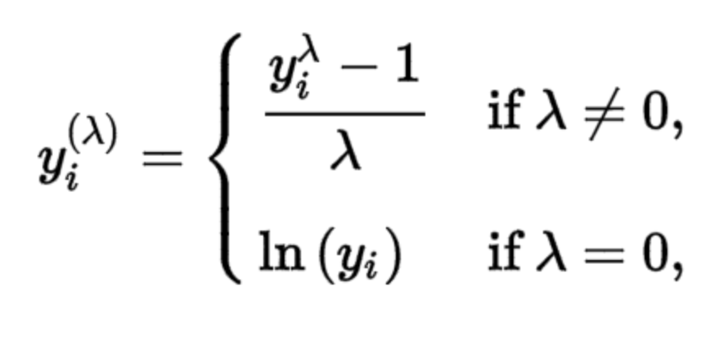
Box Cox Transformation
Box Cox transformation transforms non-normal dependent variables into normal distribution.
The mathematical formula for box cox transformation is shown:

Slide 5
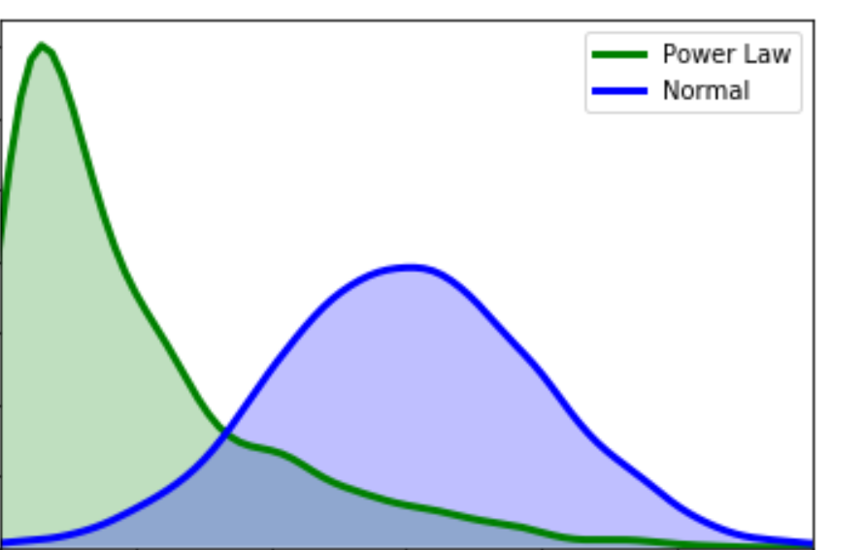
Box Cox Transformation
y is the original time series.
y(λ) is the transformed series.
To find the optimal value of lambda bet -5 and +5 is to minimize the variance of the time series.

